Slide 1


Essentials of Microsoft Word
From Basics to Advance
Module 1: Preliminary
Department of Academic Operations

Slide 2


Prerequisites
Microsoft Word 2010, Word 2013 or Word 2016 installed on your computer
No prior Microsoft Word Knowledge is needed
Department of Academic Operations
2

Slide 3
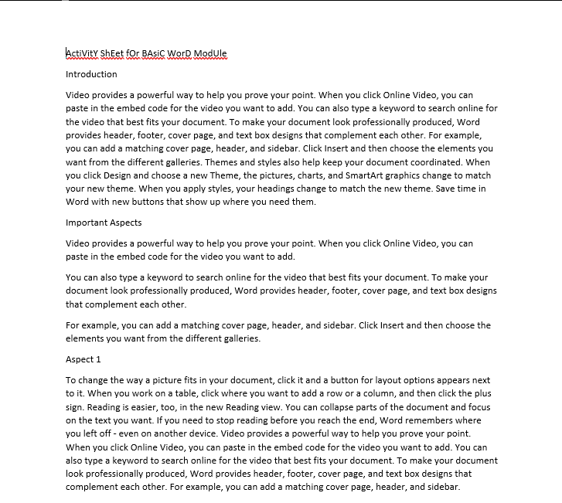
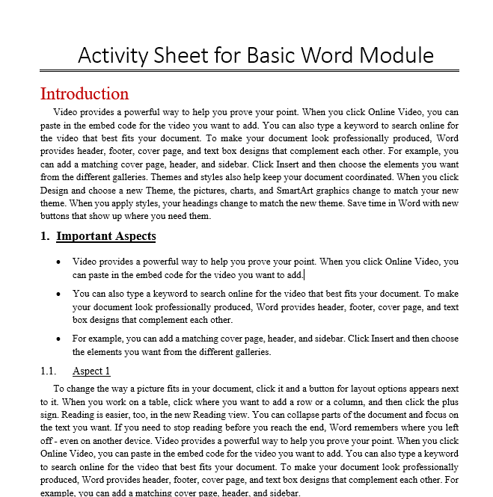
From
To

Slide 4


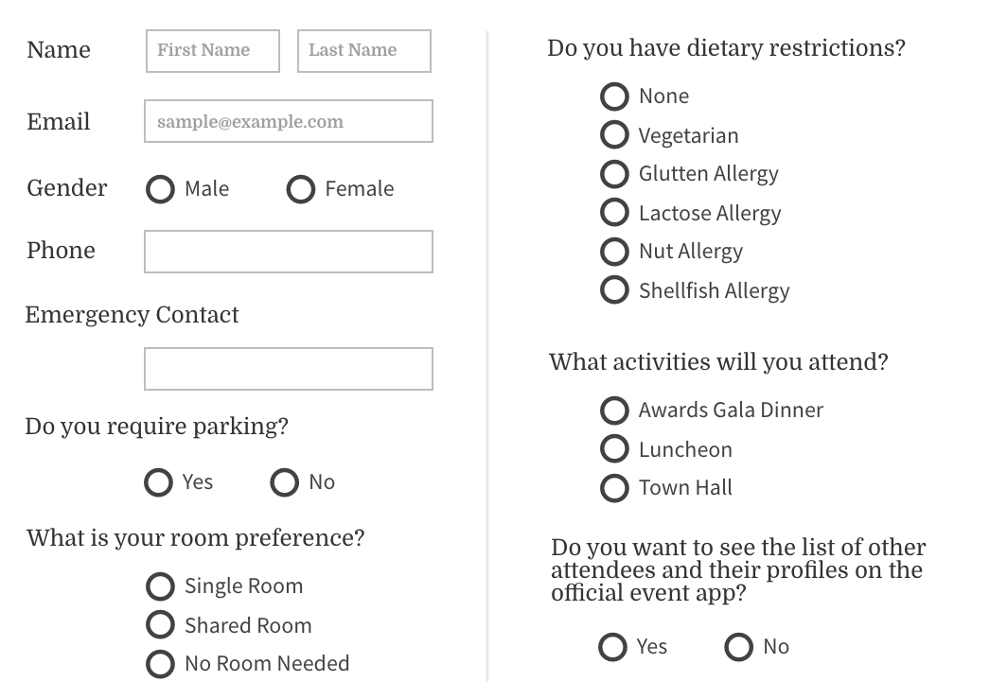

Documents with annoying formatting errors
Formatting a document with appropriate tools helps in saving a significant amount of time
Can create useful templates, forms and much more
Smartly creating the documents requires lesser efforts

Slide 5

Modules of Training
Advance
3
Track changes, document protection, templates, Citations, Cross references
Intermediate
2
Tables, Pictures, Videos, Footnotes end notes ,Mail merge, Creating forms.
Basic
1
Interface, File tab, Formatting, Page layout, Spellcheck.

Slide 6




Components of the Session
Microsoft
Word Interface
The “FILE” Tab
Formatting a Microsoft Word Document
Page Layout Techniques

Slide 7

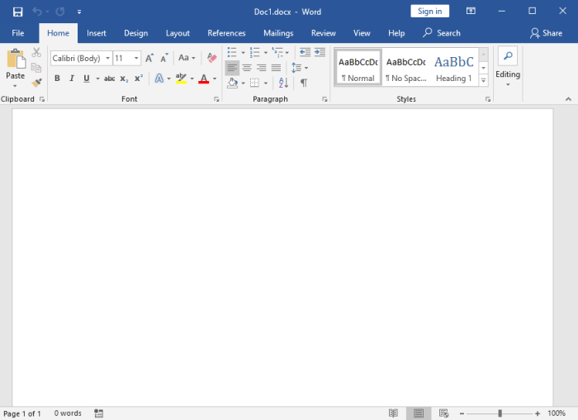
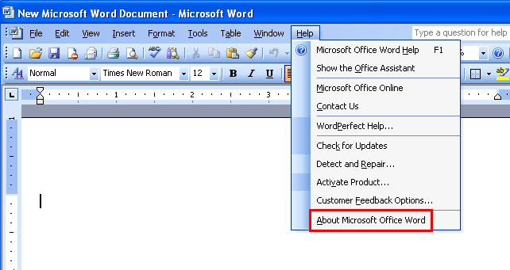
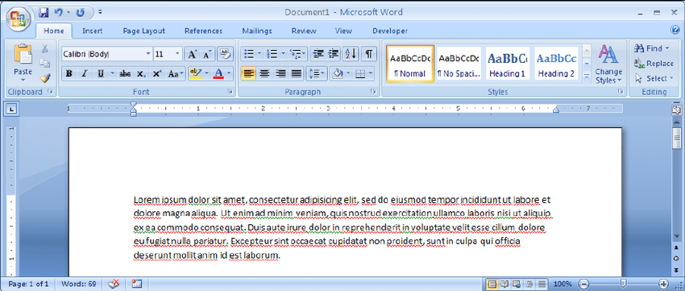
Microsoft Word Interface

Slide 8
MS Word 2003
MS Word 2010
MS Word 2007

Slide 9
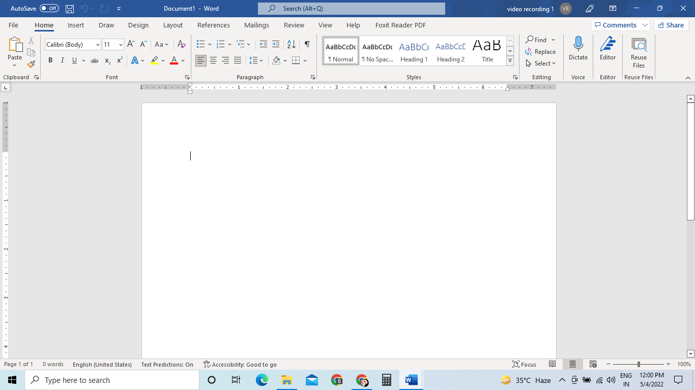
Quick Access Tool Bar
Tab Stop Control
Title Bar
Ribbon
Insertion Point
Scroll Bar
Ruler
Document Window
View Shortcut &
Zoom Control
Status Bar

Slide 10
Quick Access Tool Bar
Tab Stop Control
Title Bar
Ribbon
Insertion Point
Scroll Bar
Ruler
Ruler
Document Window
View Shortcut &
Zoom Control
Status Bar

Slide 11
Quick Access Tool Bar
Tab Stop Control
Title Bar
Ribbon
Insertion Point
Scroll Bar
Ruler
Ruler
Document Window
View Shortcut &
Zoom Control
Status Bar

Slide 12
Quick Access Tool Bar
Tab Stop Control
Title Bar
Ribbon
Insertion Point
Scroll Bar
Ruler
Ruler
Document Window
View Shortcut &
Zoom Control
Status Bar

Slide 13
Quick Access Tool Bar
Title Bar
Tab Stop Control
Ribbon
Insertion Point
Scroll Bar
Ruler
Ruler
Document Window
View Shortcut &
Zoom Control
Status Bar

Slide 14
Quick Access Tool Bar
Title Bar
Ribbon
Tab Stop Control
Insertion Point
Scroll Bar
Ruler
Ruler
Document Window
View Shortcut &
Zoom Control
Status Bar

Slide 15
Quick Access Tool Bar
Title Bar
Ribbon
Tab Stop Control
Insertion Point
Scroll Bar
Ruler
Ruler
Document Window
View Shortcut &
Zoom Control
Status Bar

Slide 16
Quick Access Tool Bar
Title Bar
Ribbon
Tab Stop Control
Insertion Point
Scroll Bar
Ruler
Ruler
Document Window
View Shortcut &
Zoom Control
Status Bar

Slide 17
Quick Access Tool Bar
Title Bar
Ribbon
Tab Stop Control
Ruler
Insertion Point
Scroll Bar
Ruler
Document Window
View Shortcut &
Zoom Control
Status Bar

Slide 18
Quick Access Tool Bar
Title Bar
Ribbon
Tab Stop Control
Ruler
Insertion Point
Scroll Bar
Ruler
Document Window
View Shortcut &
Zoom Control
Status Bar

Slide 19
Quick Access Tool Bar
Title Bar
Ribbon
Tab Stop Control
Ruler
Insertion Point
Scroll Bar
Ruler
Document Window
View Shortcut &
Zoom Control
Status Bar

Slide 20
Quick Access Tool Bar
Title Bar
Ribbon
Tab Stop Control
Ruler
Insertion Point
Scroll Bar
Ruler
Document Window
View Shortcut &
Zoom Control
Status Bar

Slide 21
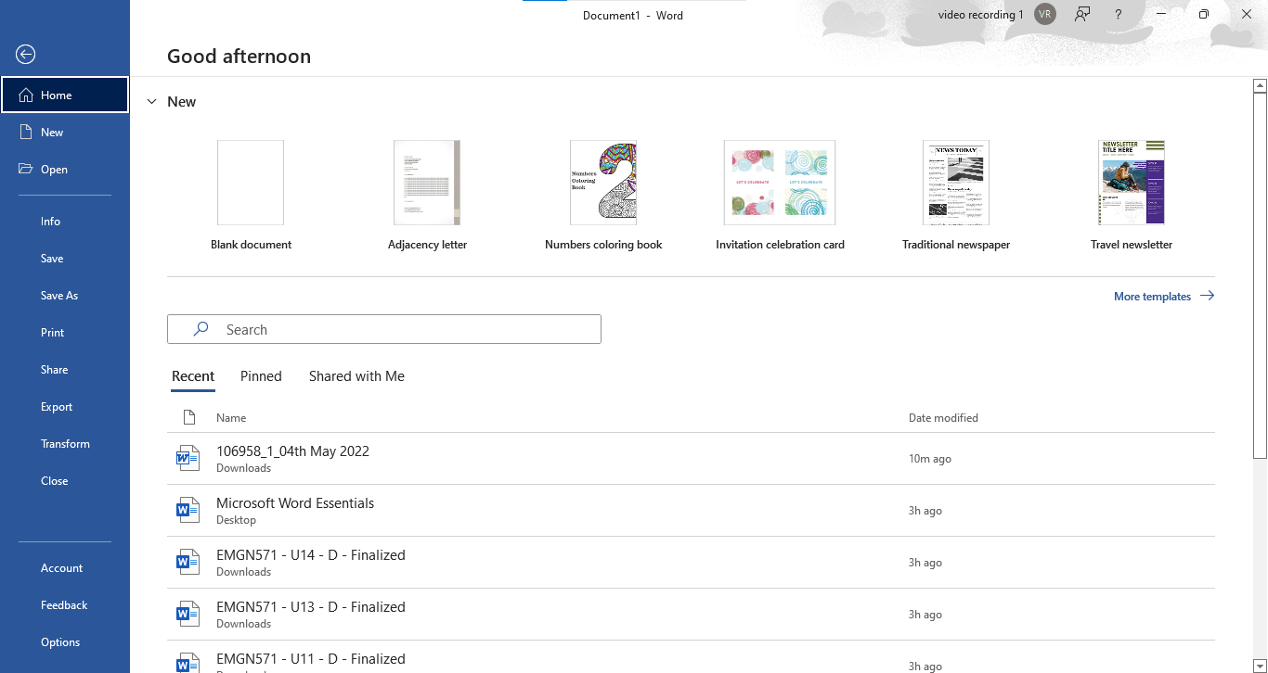
The “FILE” Tab

Slide 22
The “FILE” Tab

Slide 23
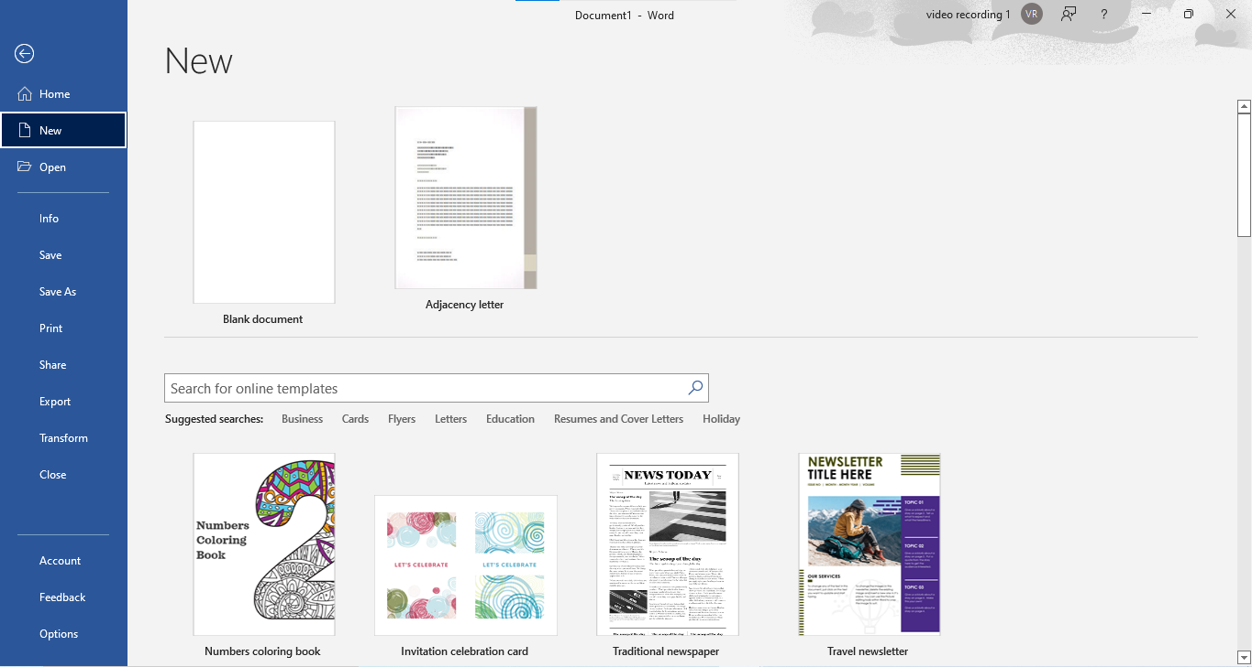
The “FILE” Tab

Slide 24
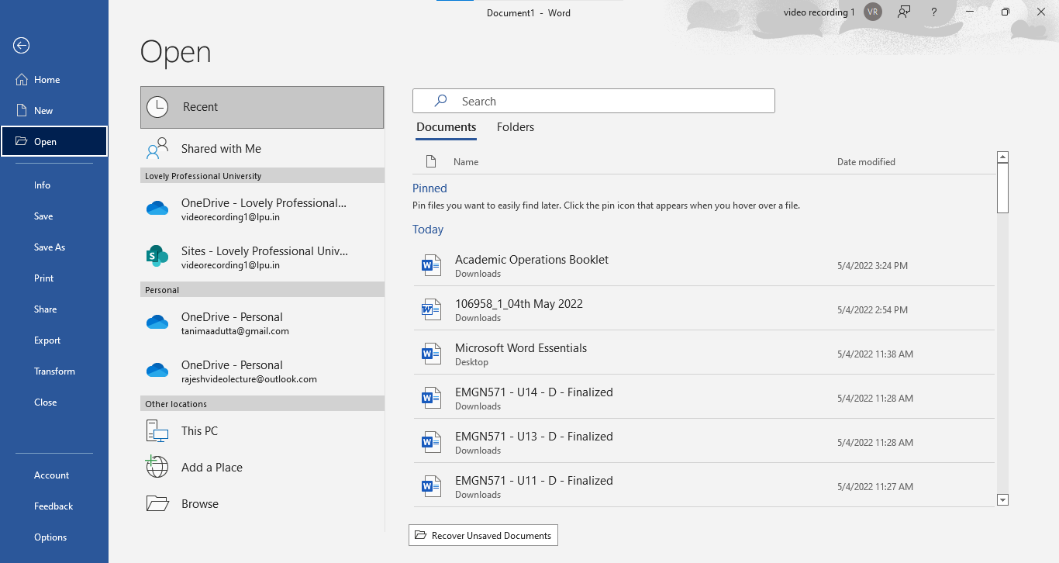
The “FILE” Tab

Slide 25
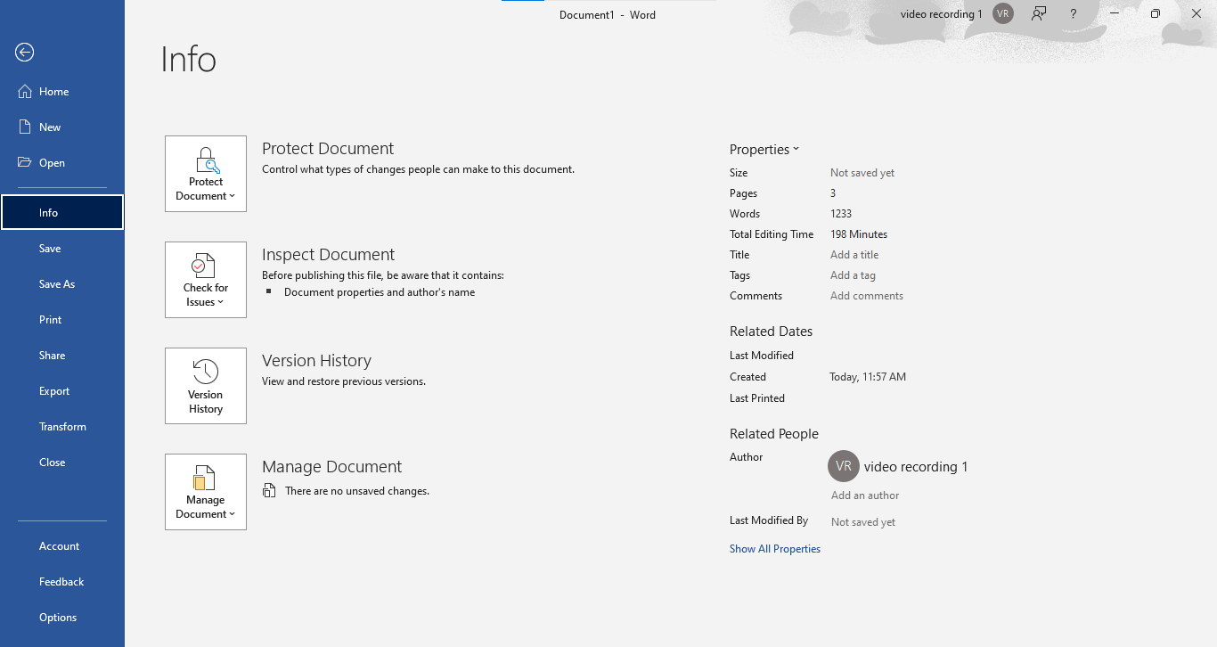
The “FILE” Tab

Slide 26
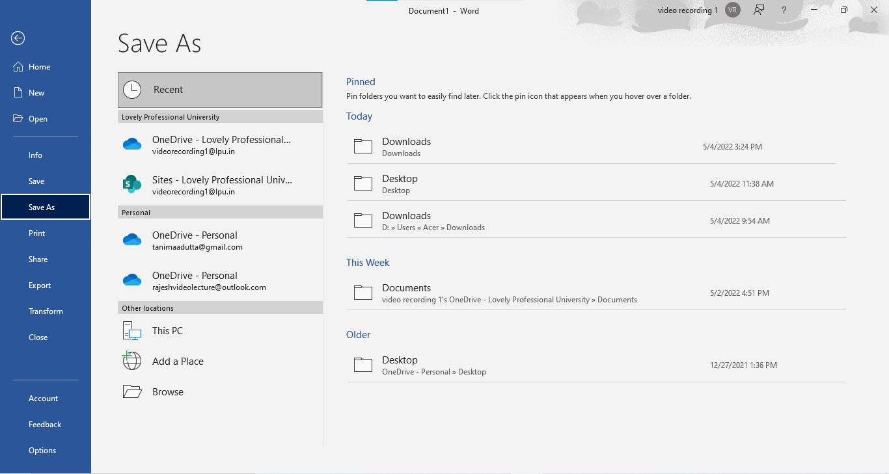
The “FILE” Tab

Slide 27
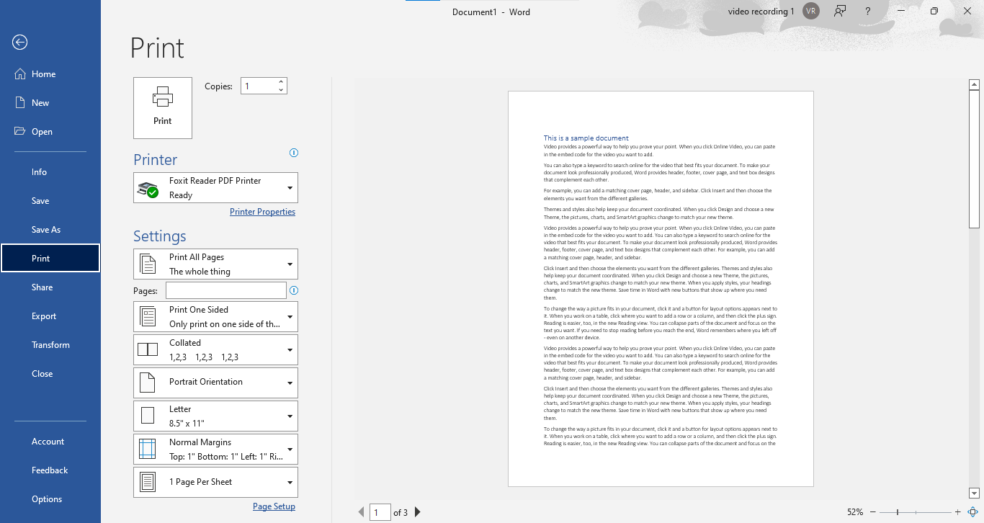
The “FILE” Tab

Slide 28
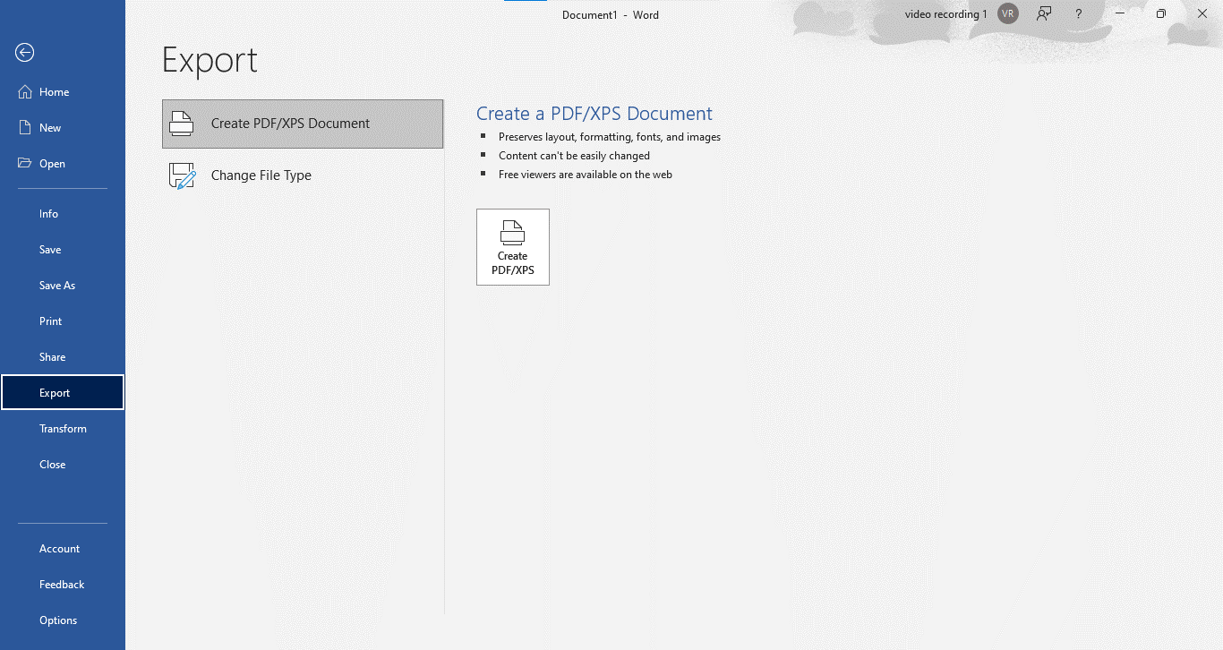
The “FILE” Tab

Slide 29
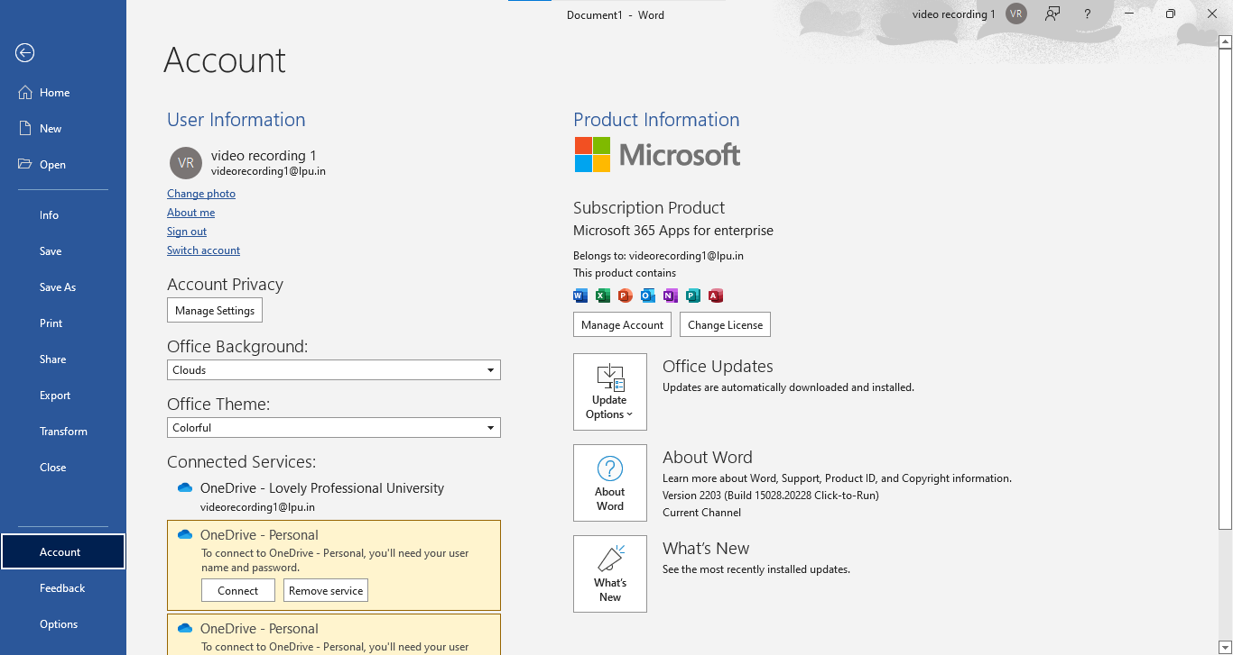
The “FILE” Tab

Slide 30
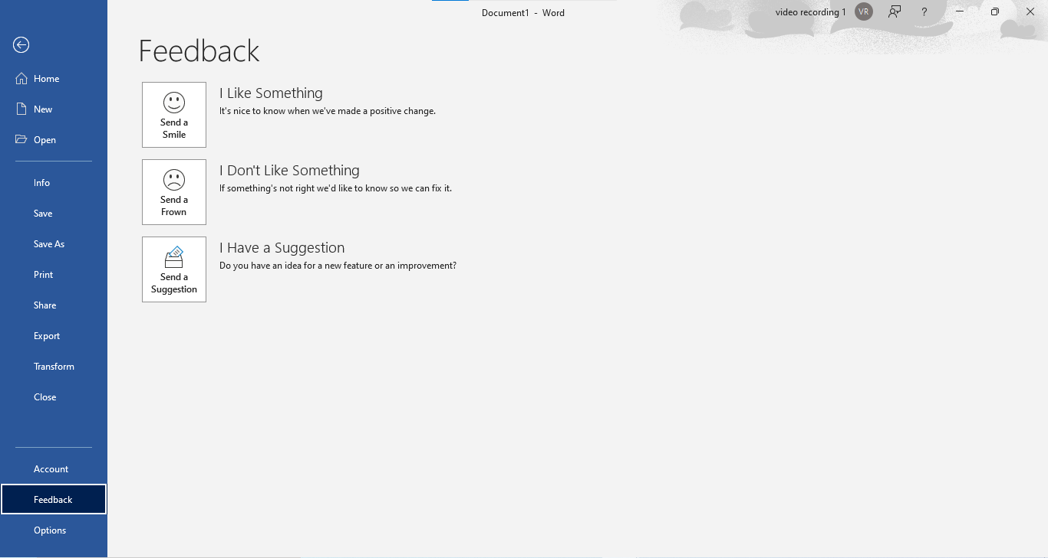
The “FILE” Tab

Slide 31
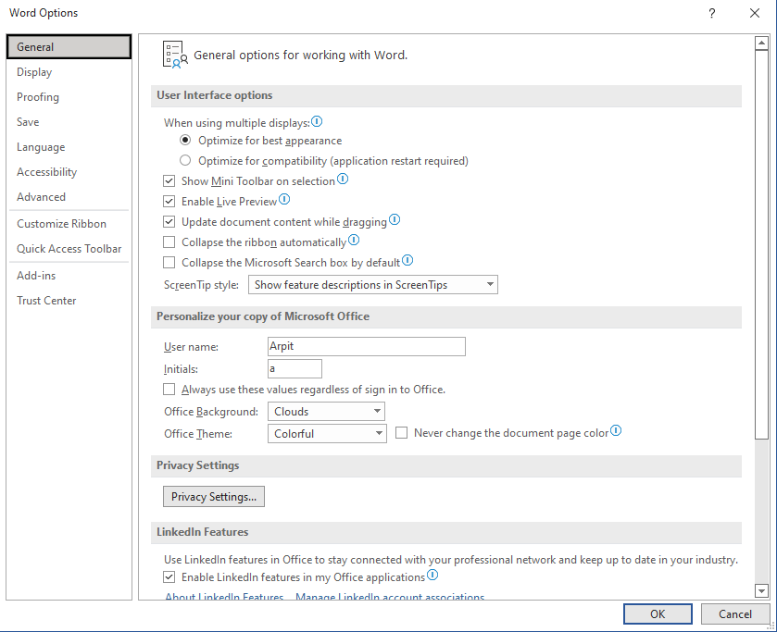
The “FILE” Tab
Feedback
Options

Slide 32

Formatting a Microsoft Word Document

Slide 33
Keyboard Shortcut Keys
To do this | Press
Open | Ctrl+O
Save | Ctrl+S
Close | Ctrl+W
Cut | Ctrl+X
Copy | Ctrl+C
Paste | Ctrl+V
Select all | Ctrl+A
Bold | Ctrl+B
Italic | Ctrl+I
Underline | Ctrl+U
Decrease font size 1 point | Ctrl+[
Increase font size 1 point | Ctrl+]
Center text | Ctrl+E
Left align text | Ctrl+L
Right align text | Ctrl+R
Justify text | Ctrl+J
Undo | Ctrl+Z
Re-do | Ctrl+Y
Key tips | Alt
Find other Microsoft Word Keyboard shortcuts on the Microsoft site:
https://support.office.com/en-us/article/Keyboard-shortcuts-for-Microsoft-Word-on-Windows-95EF89DD-7142-4B50-AFB2-F762F663CEB2

Slide 34
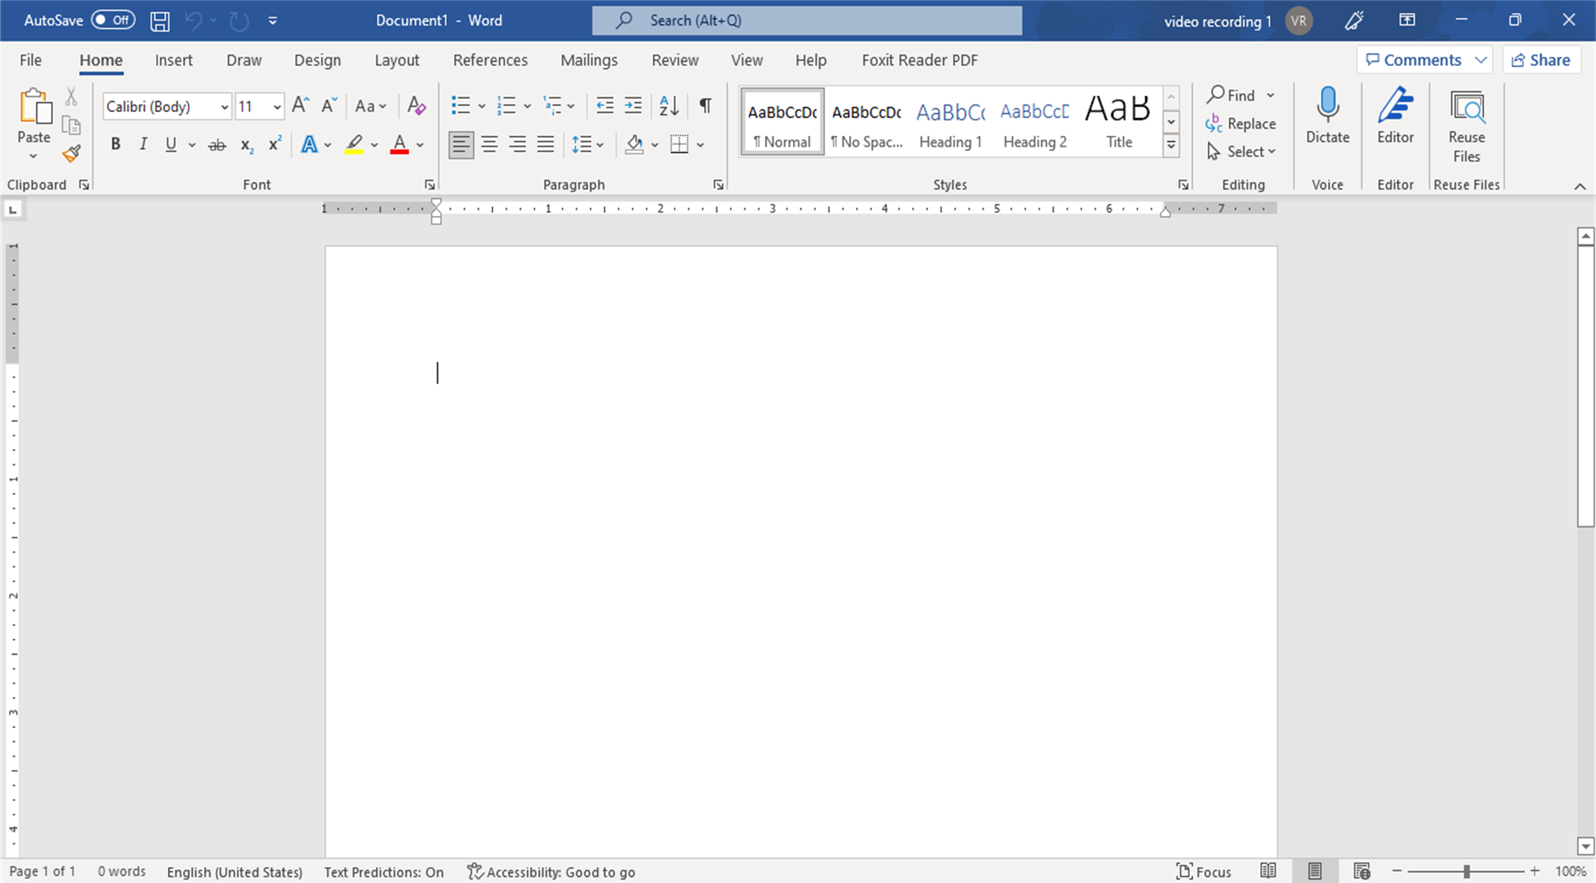
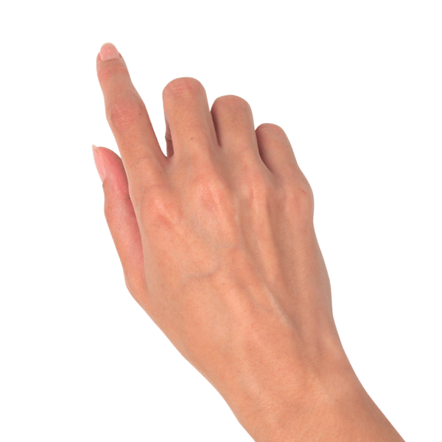
Entering Text in Word Document
Using a combination of keys on your keyboard
Using the ENTER key will create a new line and a new paragraph
Using SHIFT + ENTER will create a SOFT RETURN
Start a new line by pressing the TAB key will indent the line.

Slide 35
Navigating in a Word Document
Mouse scroll key
Scroll bars
Keyboard keys
Up and down arrow keys
Page up and page down keys
Find option on Home tab
Navigation Pane in View tab

Slide 36
Selecting Text in Word Document
Select a Single Word
Selects to the Paragraph Mark
1
2
DOUBLE CLICK
TRIPLE CLICK
4
3
CLICK AND DRAG
CTRL + SHIFT + ARROWS
Select Specific Text
A Word at a Time

Slide 37
A Closer Look Towards the HOME TAB

Slide 38
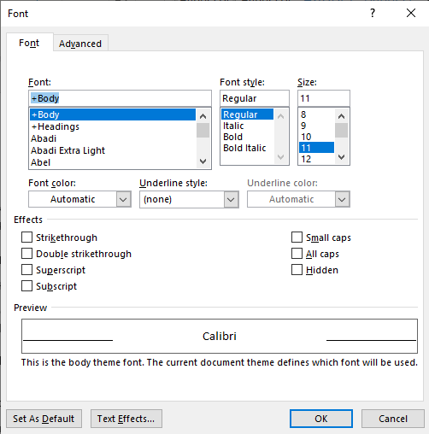
Formatting Text In Word Document

Slide 39
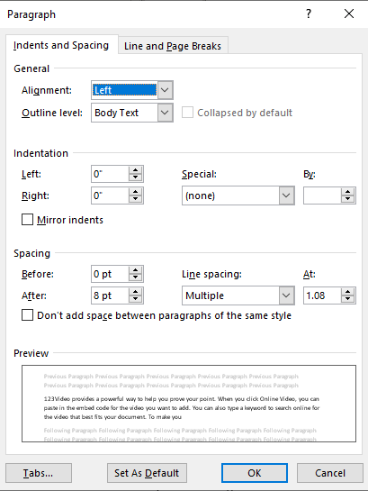
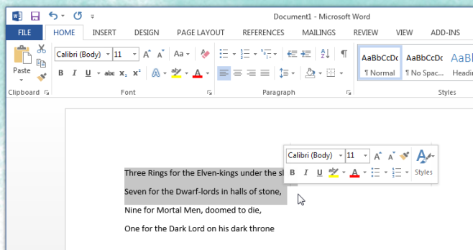
Formatting a Paragraph In Word Document

Slide 40
Formatting with Mini Toolbar

Slide 41
Microsoft Word Styles

Slide 42
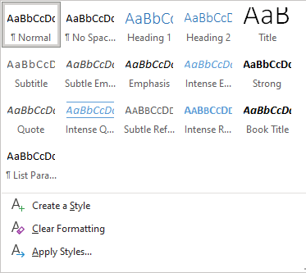
Microsoft Word Styles

Slide 43

Page Layout Techniques

Slide 44
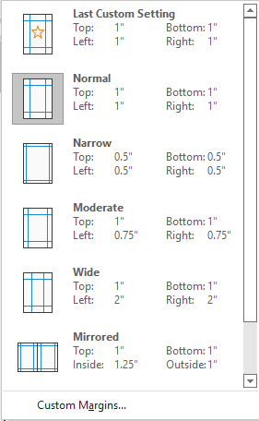

Slide 45
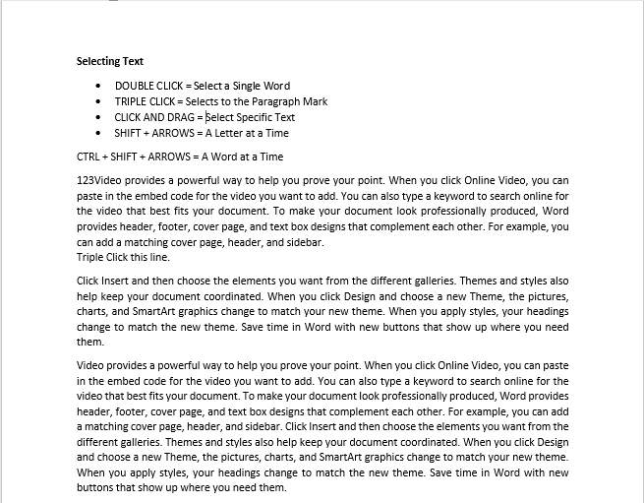
Word Document Margins
Top Margin
Left Margin
Right Margin
Bottom Margin

Slide 47
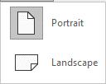
Landscape
Portrait

Slide 48
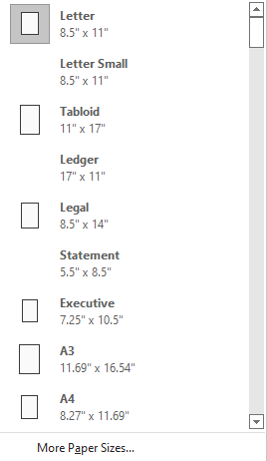
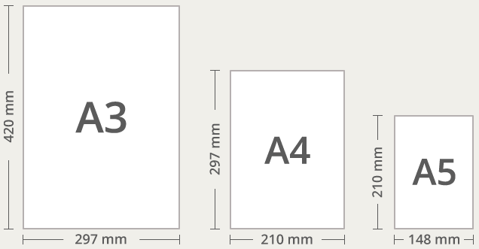
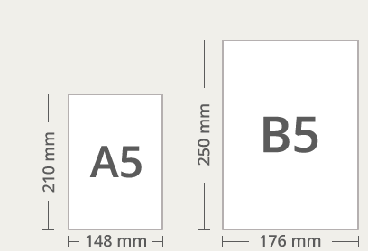
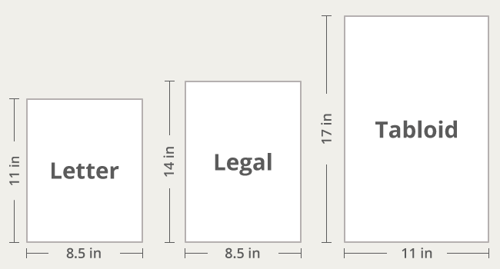

Slide 49
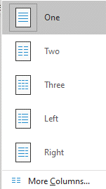
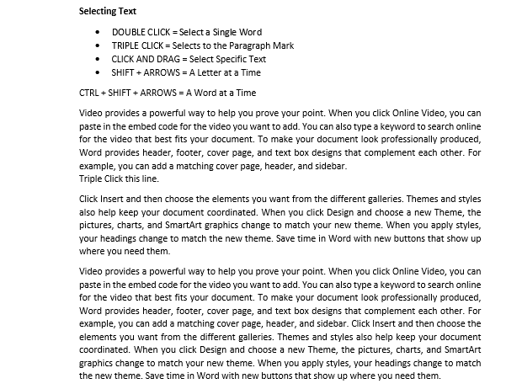
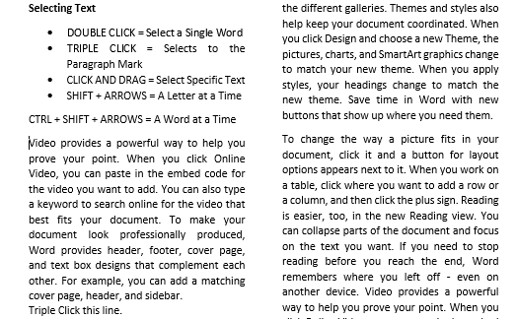
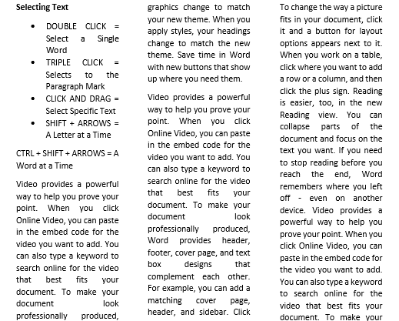
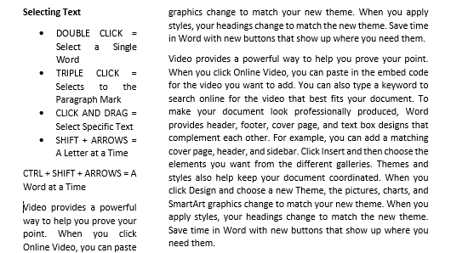
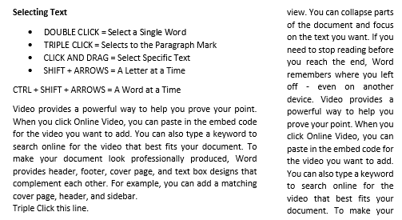
One
Two
Three
Left
Right

Slide 50
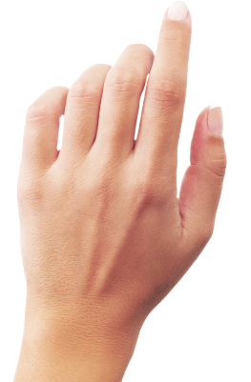
Working with Page Break
1
2
Generally, word automatically implement page break once the content fills the page completely.
But at times, a document consist of several sections which is required to be start from new page.

Slide 51
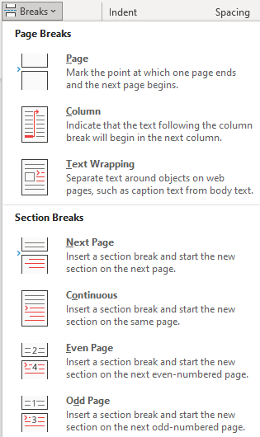

Slide 52
Somethings about Headers and Footers

Slide 53
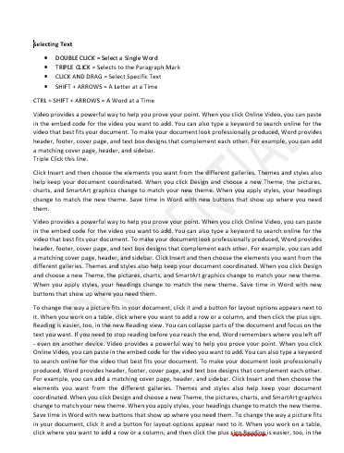
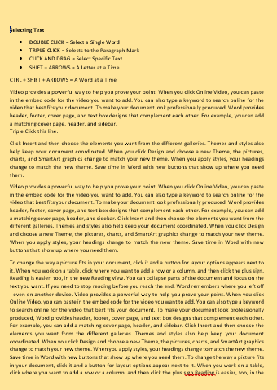
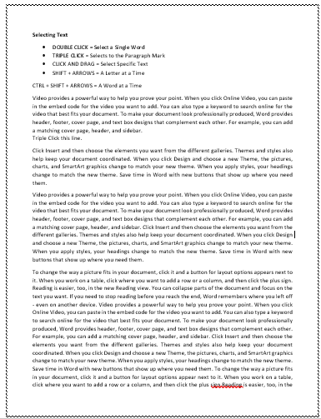
Working with Page Background

Slide 54
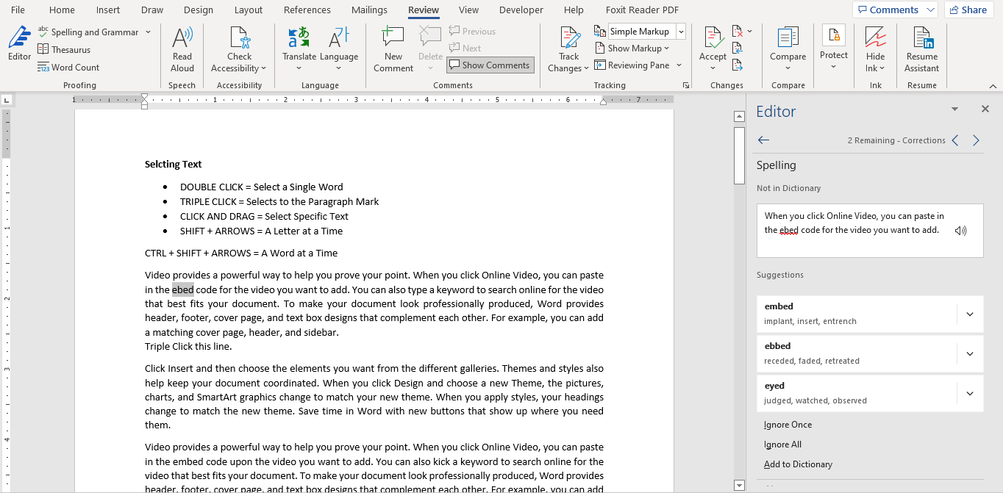
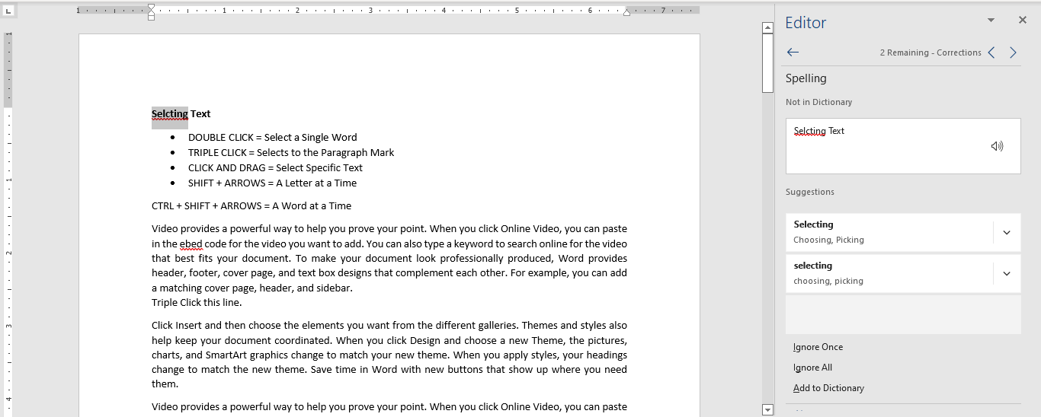
Using Spell Checker and Autocorrect

Slide 55




